Slide 1


CSE 455 Software Testing
Lecture 5
This course is offered to the students of students of BS Software Engineering who are enrolled in 8th semester

Slide 2
Course instructor Yella mehroze
yellamehroze@cuilahore.edu.pk

Slide 3

Performance Testing
Notes:
NOTE:
To change the image on this slide, select the picture and delete it. Then click the Pictures icon in the placeholder to insert your own image.

Slide 4
Outline
Introduction
Types of performance testing
Factors governing performance testing
Methodology for performance testing
Tools for Performance Testing

Slide 5
Performance Testing
Why we need to have performance testing?
What we want to achieve?
High speed
Scalability
Stability
Notes:
performance tests reveal how a system behaves and responds during various situations. A system may run very well with only 1,000 concurrent users, but how would it run with 100,000? In terms of performance, we wish to achieve high speed, scalability, and stability of the system

Slide 6
Performance Testing
In software engineering, performance testing is a practice performed to determine how a system performs in terms of responsiveness and stability under a particular workload.
It can also serve to investigate, measure, validate or verify other quality attributes of the system, such as scalability, reliability and resource usage.

Slide 7
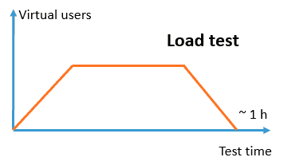
Types of Performance Testing
Load Test
Meant to simulate the maximum use of the system
We must analyze
The number of users that will have access
The operations that will be executed

Slide 8
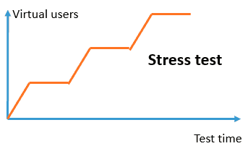
Types of Performance Testing
Stress test
The purpose is to find the stepping up breaking point
It is achieved by executing the most accessed transactions in an incremental manner as to the number of users, until the system fails
This will indicate
The maximum number of users that the system can support, with the infrastructure in which it is installed
How long it takes to recover regular functioning after the system has been down for a period

Slide 9
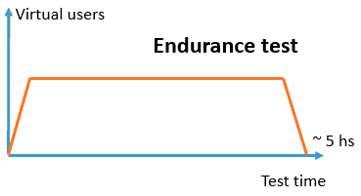
Types of Performance Testing
Endurance test
Meant to test the system during longer periods of time, in order to reveal other types of problems
It may result in increased number of problems.
In the case of a memory leak
Analyze the system’s behavior following a specific period in operation

Slide 10
Types of Performance Testing
Throttle test
A simulation of the load, with limited speed of connection of users to analyze the response time.
Speed simulators or traffic shapers are used in these tests.
Notes:
Traffic shaping (also known as packet shaping) is a computer network traffic management technique which delays some or all datagrams to bring them into compliance with a desired traffic profile. Traffic shaping is used to optimize or guarantee performance, improve latency, and/or increase usable bandwidth for some kinds of packets by delaying other kinds. It is often confused with traffic policing, the distinct but related practice of packet dropping and packet marking.

Slide 11
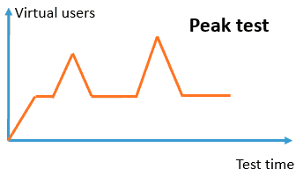
Types of Performance Testing
Peak test
To analyze the system’s behavior when exposed to intensity peaks mixed with regular load
It shows the recovery after the increased load

Slide 12
Types of Performance Testing
Scalability test
It analyses that how system escalates
It indicates, for example,
How many more users we can support if another application server is added
Improvements in timing when we add more CPU to the database server

Slide 13
Factors Governing Performance Testing
Throughput
Response time
Tuning
Competitive analysis / Benchmarking
Resource Availability / Capacity Planning

Slide 14
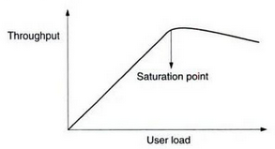
Throughput
Throughput The capacity of the system or the product in handling multiple transactions is called throughput
Number of requests or business transactions processed by the product in a specified time duration
The throughput varies according to the load the product is subjected to
The optimum throughput is represented by saturation point that is maximum throughput
The load to the product can be increased by increasing the number of users or by increasing the number of concurrent operations of the product
Notes:
In above example it can be noticed that initially the throughput keeps increasing as the user load increases. This is the ideal situation for any product and indicates that the product is capable of delivering more when there are more users trying to use the product. In the second part of the graph, beyond certain user load conditions, it can be noticed that throughput comes down. This is the period when the users of the system notice a lack of satisfactory response and the system starts taking more time to complete business transactions. The optimum throughput is represented by the saturation point and is the one that represents the maximum throughput for the product.

Slide 15
Response Time
Response Time- Delay between the point of request and the first response from the product
In a client-server environment, throughput represents the number of transactions that can be handled by the server and response time represents the delay between the request and response
Not all the delays between request and response are caused by products
Some delays are due to product while others may be due to environment

Slide 16
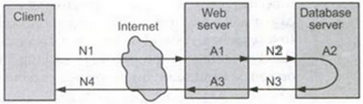
Latency
Latency- is a delay caused by the application, operating system and by the environment that are calculated separately
In the following example latency and response time can be calculated as
Network Latency= N1 + N2 + N3 + N4
Product Latency= A1 + A2 + A3
Actual Response Time= Network Latency + Product Latency

Slide 17
Latency
Any improvement that is done in the product can only reduce the response time by the improvements made in A1, A2 and A3
If the network latency is more relative to the product latency, in such case it will be worthwhile looking at improving the network infrastructure

Slide 18
Tuning
Tuning- is a procedure by which product performance is enhanced by setting different values to parameters of the product, operating system and other components
Tuning improves performance without touching the source code of the product
Product parameter or variable values need to be changed to get optimum performance for a particular configuration

Slide 19
Benchmarking and Capacity Planning
Competitive analysis / Benchmarking- Performance testing, where throughput and response time of competitive products are compared
Its not easy to decide which parameters must be compared
No two products are same in
Features
Cost
Functionality
Careful analysis is required to chalk out list of transactions to be compared
This analysis will improve performance of the product
Resource Availability / Capacity Planning- The exercise to find out what resources and configurations are needed
The purpose is to help customers plan for the set of hardware and software resources prior to installation or up-gradation of the product

Slide 20
Methodology for Performance Testing
It involves following steps
Collecting requirements
Writing test cases
Automating performance test cases
Executing performance test cases
Analyzing performance test results
Performance tuning
Performance benchmarking
Recommending right configuration for the customers

Slide 21
1. Collecting Requirements
Performance testing needs elaborated in documentation and environment set up
Expected results may not well known in advance
Performance testing requirements collection may face following challenges
Requirement should be testable
Not all features / functionality can be performance tested.
A performance test can be carried out for a completely automated product
Requirement needs to clearly state what factors need to be measured and improved
Requirement needs to be associated with the actual number or percentage of improvement that is desired (Example: ATM money withdrawal shall be completed within two minutes)

Slide 22
1. Collecting Requirements
Sources for driving performance testing requirements are:
Performance compared to the previous release of the same product
Example: ATM withdrawal transaction will be faster than the previous release by 10 %
Performance compared to the competitive products
Example: ATM withdrawal will be as fast as or faster than competitive product XYZ
Performance compared to absolute numbers derived from actual need
Example: ATM machine should be capable of handling 1000 transactions per day with each transaction not taking more than a minute
Performance numbers derived from architecture and design

Slide 23
1. Collecting Requirements
Performance Testing Requirements Types
There are two types of performance testing requirements
Generic Requirements: Those requirements that are common across all products in the product domain area
For some of the products they are mandated by SLAs (Service Level Agreements) and standards
For example, the time taken to load a page, initial response when a mouse is clicked and time taken to navigate between screens
Specific Requirements: Those requirements that depend on implementation for a particular product and differ from one product to another in a given domain
For example the time taken to withdraw cash in an ATM

Slide 24
Example of performance test requirements
Transaction | Expected Response Time | Loading Pattern/ throughput | Machine Configuration
ATM cash withdrawal | 2 Sec | Up to 10,000 simultaneous access by users | Pentium IV/512 MB RAM/ Broadband Network
ATM cash withdrawal | 40 Sec | Up to 10,000 simultaneous access by users | Pentium IV/512 MB RAM/ Dial-up Network
ATM cash withdrawal | 4 Sec | More than 10,000 but below 20,000 simultaneous access by users | Pentium IV/512 MB RAM/ Broadband Network

Slide 25
2. Writing Test Cases
Test cases for performance testing should have the following details defined
List of operations and business transactions to be tested
Steps for executing those operations/transactions
List of products, OS parameters that impact the performance testing and their values
Loading pattern
Resources and their configuration
The expected result
The product version/competitive products to be compared with and related information such as their corresponding fields

Slide 26
3. Automating Performance Test Cases
Performance testing should be automated due to following characteristics
Performing testing is repetitive
Performance test cases cannot be effective without automation
The results of performance testing need to be accurate, and manual calculations can introduce inaccuracy
Performance testing takes into account several factors and it is difficult to remember and use them if tests are done manually
The analysis of performance results need to take into account related information that is impossible to do in case of manual testing

Slide 27
4. Executing Performance Test Cases
Performance testing involves less effort for execution but more effort for planning, data collection, and analysis
The most effort consuming aspect in execution is usually data collection
Data corresponding to following points need to be collected
Start and end time of test case execution
Log and trace/audit files of the product and operating system (for future debugging and repeatability process)
Utilization of resources (CPU, Memory, disk, network utilization, and so on)on a periodic basis
Configuration of all environmental factors (hardware, software, and other components)
The response time, throughput, latency and so on as specified in the test case documentation

Slide 28
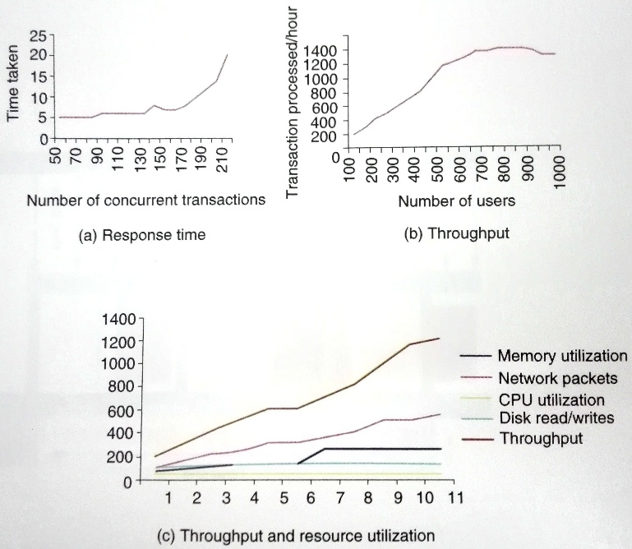
Plotting of Performance Test Results

Slide 29
5. Analyzing the Performance Test Results
Most complex part of performance testing
It requires product knowledge, analytical thinking and statistical background of analyst
Calculate the mean of performance test result
Calculate the standard deviation
Removing the noise and re-plotting and re-calculating the mean and standard deviation
When there are a set of performance numbers that come from multiple runs of the same test, in a few iterations there can be some errors committed by scripts, software or human. When these values plotted on a chart, one or two values that are out of range may prevent meaningful analysis. Such values can be removed and the process of removing these values is called noise removal
The mean and standard deviation needs to be recalculated

Slide 30
5. Analyzing the Performance Test Results
The data coming from cache need to be differentiated from the data that gets processed by the product
Differentiating the performance data when the resources are available completely as against when some background activities were going on
Performance numbers are to be reproducible for customers to ensure that performance tests are repeated multiple times
Standard deviation represents how much the data varies from the mean

Slide 31
5. Analyzing the Performance Test Results
Performance Test Results Example If the average response time of 100 people withdrawing money from ATM is 100 seconds and the standard deviation is 2, then there is greater chance that this performance data is repeatable than in a case where the standard deviation is 30.
Standard deviation close to zero means the product performance is highly repeatable.

Slide 32
6. Performance Tuning
Narrow down the list of parameters that impact the performance
Performance test cases are repeated for different values of those parameters
Understanding each parameter and its impact on the product is not sufficient for performance tuning
Combination of parameters too causes changes in performance
The relationship among various parameters and their impact too is very important to performance tuning

Slide 33
6. Performance Tuning
Steps involved in getting the optimum mileage are
Tuning the product parameters
Product parameters may be
Parallel transactions
Caching and memory size
Creating background activities
Providing better priority to highly used operations/transactions
Changing the sequence of a set of operations to suit the resource availability
Setting different values to these parameters enhances the product performance

Slide 34
6. Performance Tuning
Tuning the operating system and parameters
Operating system parameters may be
File system parameters (Number of open files permitted)
Disk management parameters (Simultaneous disk reads/ writes)
Memory management parameters (Virtual memory, page size and number of pages)
Processor management parameters (Enabling/ disabling processors in multiprocessor environment)
Network parameters (Setting TCP/ IP time out)
The OS parameters need to be tuned before application/product tuning is done
Results of performance tuning are published in the form of a guide called Performance Tuning Guide for customers so that they can get benefit from this exercise
The guide explains in detail the effect of each product and OS parameter on performance
Notes:
A page, memory page, or virtual page is a fixed-length contiguous block of virtual memory, described by a single entry in the page table.
In computing, a file system or filesystem (often abbreviated to fs), controls how data is stored and retrieved. Without a file system, information placed in a storage medium would be one large body of data with no way to tell where one piece of information stops and the next begins. By separating the data into pieces and giving each piece a name, the information is easily isolated and identified. Taking its name from the way paper-based information systems are named, each group of data is called a "file".

Slide 35
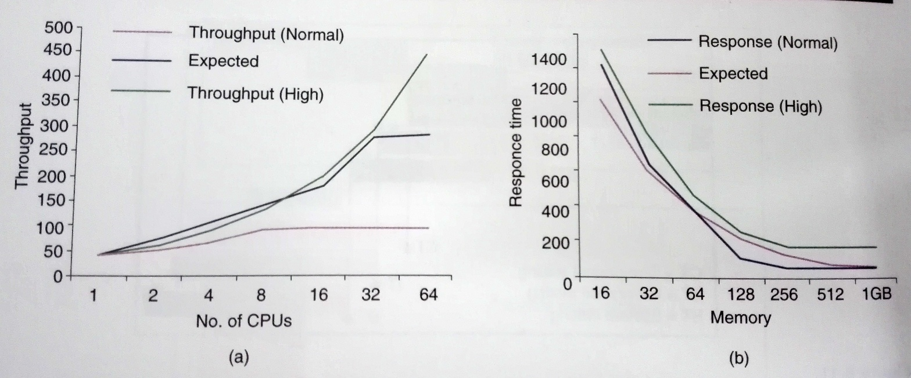
Expected Results, Performance Results Without Tuning and Tuned Results

Slide 36
7. Performance Benchmarking
Performance benchmarking is about comparing the performance of product transactions with that of the competitors
No two products can have same architecture, design, functionality and code
Customers can also be different
An independent test team or an independent organization does performance benchmarking
The person doing performance benchmarking needs to have expertise in all products being compared

Slide 37
7. Performance Benchmarking
Steps involved in performance benchmarking are
Identifying the transactions/scenarios and the test configuration
Comparing the performance of different products
Tuning the parameters of the products being compared fairly to deliver the best performance
Publishing the results of performance benchmarking
Tunable parameters for the various products may be different
Understanding those parameters and their impact on performance is very important in doing comparison
This is one place where bias can come in

Slide 38
7. Performance Benchmarking
There could be three outcomes
First outcome can be positive where a set of transactions or scenarios outperform with respect to competition
Second outcome can be neutral where a set of transactions are comparable with that of competition
The third outcome can be negative where a set of transaction under-perform compared to that of the competition. Performance tuning exercise need to be performed for this set of transactions
Two types of publications are involved to publish performance benchmarking results
Internal, confidential publication to product teams, containing all the three outcomes and recommended set of actions
Benchmarks conducted by independent organizations are published as audited benchmarks

Slide 39
8. Capacity Planning
In capacity planning Performance requirements and performance results are taken as input requirements and the configuration needed to satisfy that set of requirements are derived.
You need to understand two types of requirements for capacity planning
Resource Requirements requires a clear understanding of resource requirements for transactions/scenarios
Transactions associated with load conditions can be
Disk intensive
CPU intensive
Network intensive
Memory intensive
Or a combination of above

Slide 40
8. Capacity Planning
Load patterns can be decided on the following basis
Actual customer requirements for immediate need(short term)
Requirements for the next few months (medium term)
Requirements for the next few years (long term)
Consider future requirements during the capacity planning
Capacity planning corresponding to short, medium and long term requirements are
Minimum required configurations- denotes that with anything less than this configuration, the product may not work
Typical configuration- denotes that under that configuration, the product will work fine for meeting the performance requirements of the required load pattern and can also handle a slight increase in the load pattern
Special Configuration- denotes that capacity planning was done considering all future requirements

Slide 41
8. Capacity Planning
Two techniques playing major role in capacity planning are
Load balancing- This ensures that the multiple machines available are used equally to service the transactions. By adding more machines, more load can be handled by the product.
High availability- Machine clusters are used to ensure availability. In a cluster there are multiple machines with shared data so that if one machine goes down, the transactions can be handled by another machine in cluster

Slide 42
Tools For Performance Testing
Functional Performance Tools
WinRunner from Mercury
QA Partner from Compuware
Silktest from Segue
Load Testing Tools
Load Runner from Mercury
QA Load from Compuware
Skill Performer from Segue

